Slide 1
Detecting Shapes in Images using the Hough Transform

Slide 2
Outline
Detecting Straight Lines
Detecting Straight Lanes

Slide 3
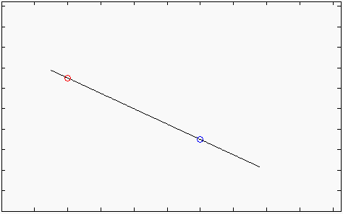

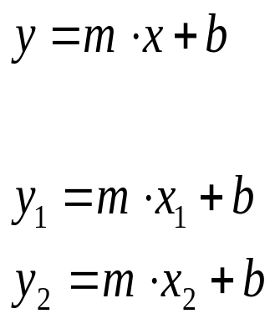
The Straight Line
(x₁,y₁)
(x₂,y₂)
For each point (x,y) in the line the following equation applies:
Therefore:

Slide 4
Multiple Lines over a single point
y=m₂x+b₂
y=m₁x+b₁
y=m₄x+b₄
(x,y)
y=m₃x+b₃
Each pair (m,b) defines a distinct straight line containing the point (x,y)

Slide 5
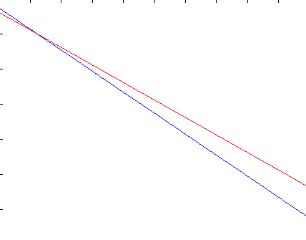
The Parameter Plane
b =-mx₁+y₁
(x₁,y₁)
(x₂,y₂)
(x₃,y₃)
b =-mx₃+y₃
b =-mx₂+y₂
Each point in the (x,y) space(image plane) is mapped to a straight line in the (m.b) space (parameter plane).
A straight line in the (x,y) space (image plane) is mapped to the intersection point of the lines corresponding to its points, in the (m.b) space (parameter plane).

Slide 6
Dealing with digital pictures
Image Plane
Parameter Plane
N pixels
N lines
M lines
M pixels
A line formed by M (N) pixels in the image space will be mapped to the intersection point of M (N) lines in the parameters space, where each line corresponds to a pixel in the image space.
The number of lines intersecting in a single point in the parameter space represents the length of the original line in the image space.

Slide 7
The Accumulator Concept
b
The (m.b) space (parameter plane) is subdivided in cells.
Each pixel (x,y) in the original image vote in the (m,b) space for each line passing through it.
The votes are summed in an Accumulator
b_{max}
b₁
N
Corresponds to a straight line
y=m₁x+b₁
of N pixels length
b_{min}
m_{min}
m₁
m_{max}
m

Slide 8

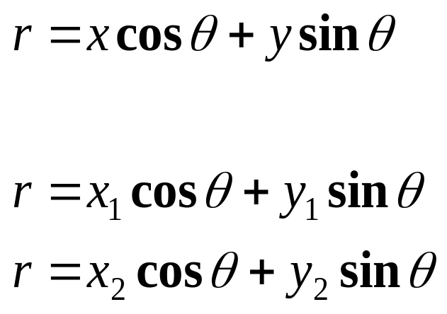
Using Polar Coordinates
For each point (x,y) in the line the following equation applies:
In particular:
(x₁,y₁)
(x₂,y₂)
r
θ

Slide 9
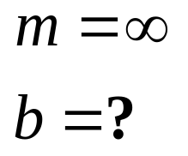
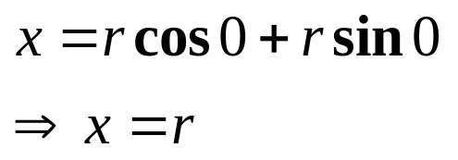
The Motivation for Polar Coordinates
Vertical lines cannot be mapped to the (m,b) space, since:
Vertical lines can be described using polar coordinates :
x = r
r

Slide 10
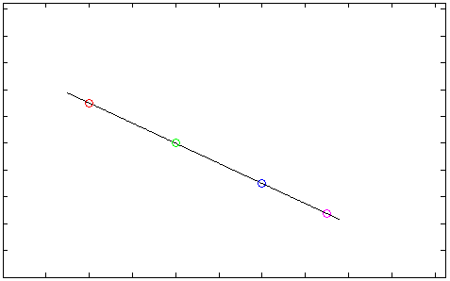
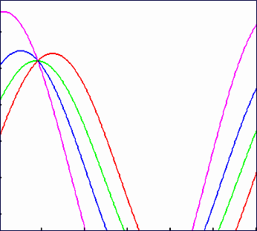
Hough Transform - The (r,θ) Space
r=x₂cosθ+y₂sinθ
r=x₄cosθ+y₄sinθ
(x₁,y₁)
r=x₁cosθ+y₁sinθ
(x₃,y₃)
(x₂,y₂)
(x₄,y₄)
r=x₃cosθ+y₃sinθ
Hough Transform - Each point in the (x,y) space is mapped to a sinusoid in the (r,θ) space.
Sinusoids corresponding to collinear points in the (x,y) space intersect at a common point in the (r,θ) space.

Slide 11
Accumulators in the (r,θ) Plane
θ
θmax
Corresponds to the straight line
r₁=xcosθ₁+xsinθ₁
of N pixels length
θ ₁
N
θ_{min}
r_{min}
r₁
r_{max}
r

Slide 12
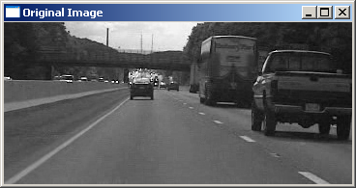
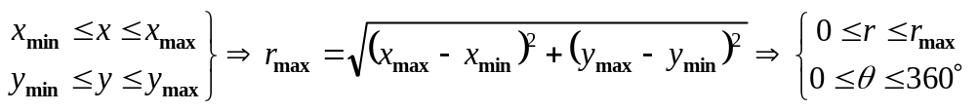
The Region of Interest (ROI)
y_{max}
r_{max}
y_{min}
x_{min}
x_{max}
The ROI is the area in the original image, where lines need to be detected. The ROI for the picture above is:

Slide 13
Longest Line Detection
Hough Algorithm
Input Image
Edge Detection
Hough Transfom
Find Max.
Draw Line
+
Output Image
Binary Image
The line is reconstructed using the equation:
r_{m}=xcosθ_{m}+ysinθ_{m}
  (Calculated for the values of (x,y) that “voted” for the accumulator cell (r_{m}, θ_{m}).
Accumulator Array
Longest Line
(r_{m},θ_{m})

Slide 14
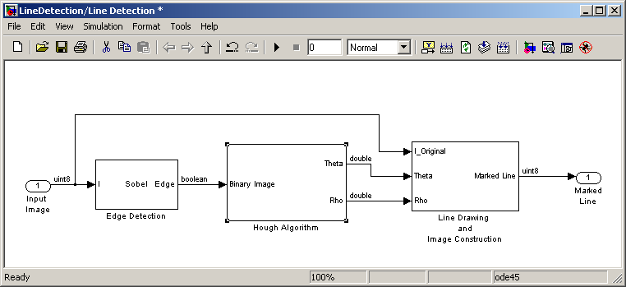
Line Detection Model

Slide 15
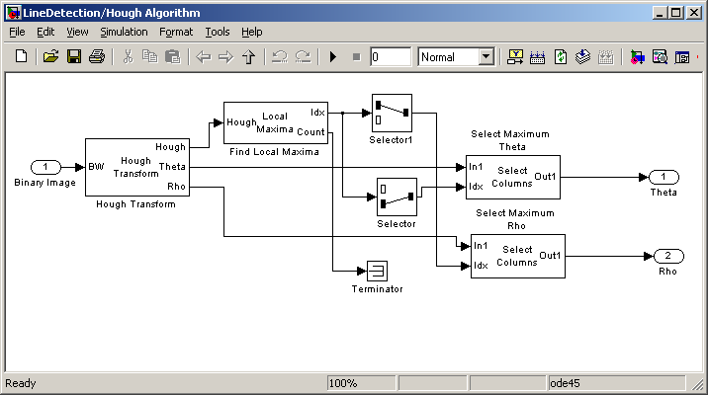
The Hough Algorithm

Slide 16
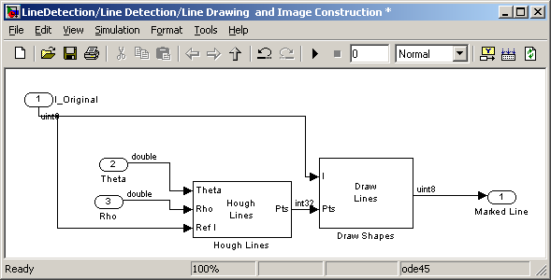
Line Drawing & Image Construction

Slide 17
Line Detection - Hands-On
Simulation
Implementation using the DSK6416

Slide 18

Simulation
MATLAB®
Display
Image File
Line
Detection

Slide 19
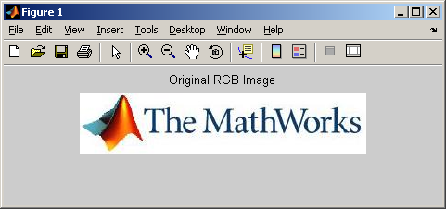
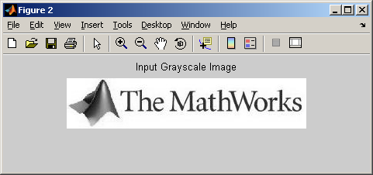

Real Time Implementation
MATLAB
Display
Image
File
Script
RGB
to Grayscale
RTDX
RTDX
DSK6416
Line
Detection

Slide 20
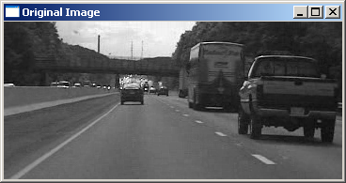
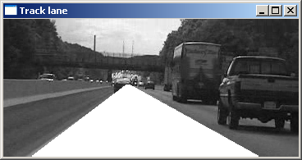
From Line to Lane
Find two longest lines in the picture
Draw Polygon

Slide 21
Lane Detection
Hough Algorithm
Input Image
Determine ROI
Enhanced
Edge Detection
Hough Transfom
Find
2 Max.
(r,θ)
Correction
Draw Lane
+
Output Image
Binary Image
Two Longest Lines
(r_{m},θ_{m}) / (r_{n},θ_{n})
Accumulator Array
Two lines are reconstructed using the equation:
r_{m}=xcosθ_{m}+ysinθ_{m}
  (Calculated for the values of (x,y) that “voted” for the two maximum values in the accumulator cell.
  A polygon is constructed connecting those lines

Slide 22
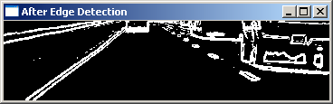
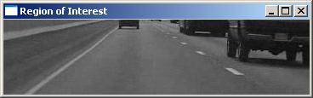
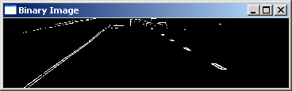
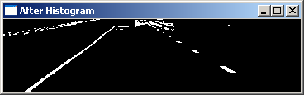
Enhanced Edge Detection
An histogram-based thresholding edge detection method enables the identification of areas where pixels change from light to dark or dark to light, which might indicate lane edges.
Edge Detection
Logical AND
Binary Image
ROI
≥
Histogram Based Threshold

Slide 23
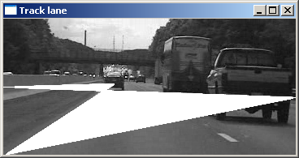
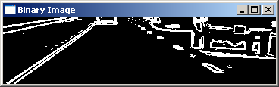
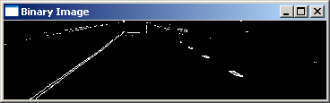
Why Enhanced Edge Detection?
Edge Detection Only
Edge Detection with Histogram Based Thresholding

Slide 24
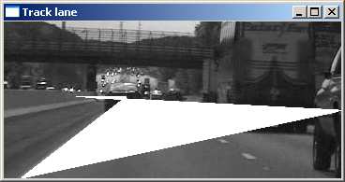
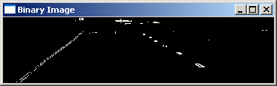
The Need for (r,θ) Correction
No Correction
Misdetection of the longest lines
(r,θ) Correction

Slide 25
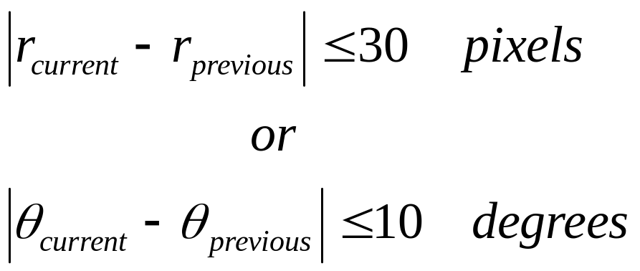
(r,θ) Correction
If the lane position given by the Hough Transform block changes abruptly with respect to its values in the previous frame, the Rho Theta Correction subsystem discards the current position and keeps the previous position. Maximum allowable variation in E and F with respect to previous values are:

Slide 26
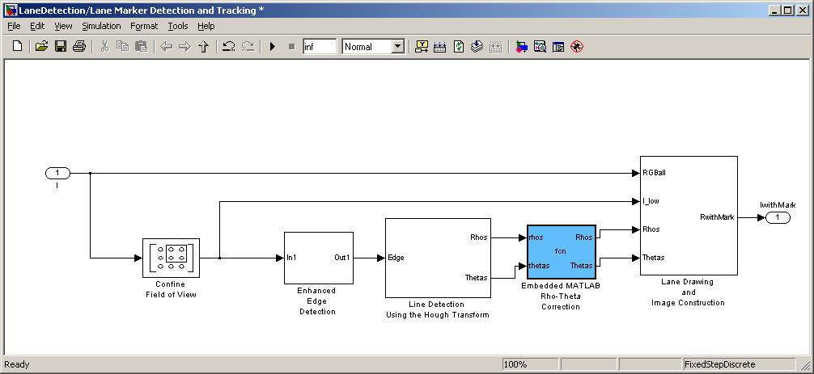
Lane Detection Model

Slide 27
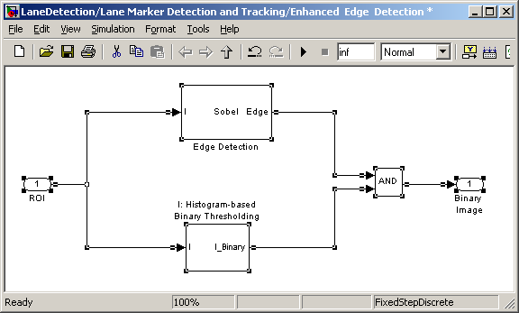
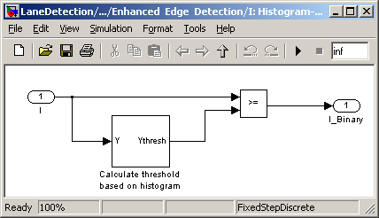
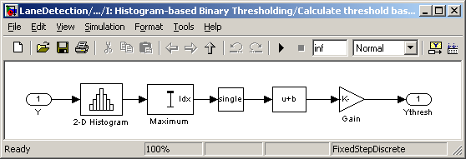
Enhanced Edge Detection

Slide 28
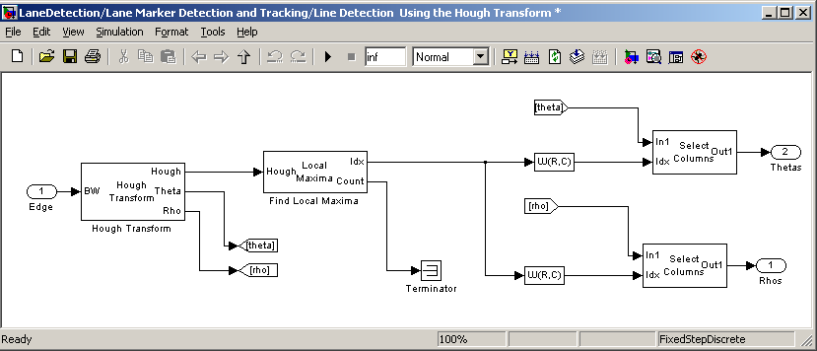
The Hough Algorithm

Slide 29
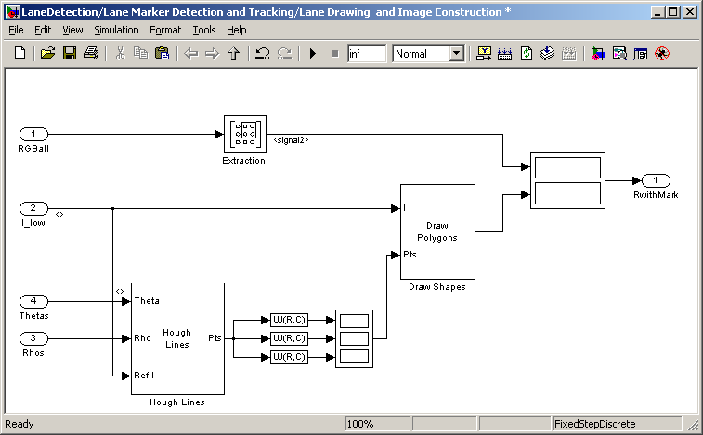
Lane Drawing

Slide 30
Lane Detection - Hands-On
Simulation
Implementation using the DM6437 DVDP

